Slide 1

An
Introduction to
Agile SCRUM Methodology

Slide 2
Introduction
Classical methods of software development have many disadvantages:
huge effort during the planning phase
poor requirements conversion in a rapid changing environment
treatment of staff as a factor of production
New methods:
Agile Software Development Methodology
Link 1: Click here
Link 2: Click here
Link 3: Click here

Slide 3
Contd…
Agile methods are considered
Lightweight
People-based rather than Plan-based
Several agile methods
No single agile method
No single definition
Agile Manifesto closest to a definition
Set of principles
Developed by Agile Alliance

Slide 4
Agile Methods
Agile methods:
Scrum
Extreme Programming
Adaptive Software Development (ASD)
Dynamic System Development Method (DSDM)
…
Agile Alliance (www.agilealliance.org)
A non-profit organization promotes agile development

Slide 5
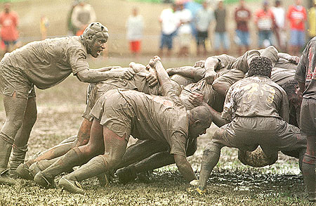
Scrum
Scrum link 1
Scrum link 2
Scrum link 3

Slide 6
Scrum in 100 words
Scrum is an agile process that allows us to focus on delivering the highest business value in the shortest time.
It allows us to rapidly and repeatedly inspect actual working software (every two weeks to one month).
The business sets the priorities. Our teams self-manage to determine the best way to deliver the highest priority features.
Every two weeks to a month anyone can see real working software and decide to release it as is or continue to enhance for another iteration.

Slide 7
Characteristics
Self-organizing teams
Product progresses in a series of month-long “sprints”
Requirements are captured as items in a list of “product backlog”
No specific engineering practices prescribed
Uses generative rules to create an agile environment for delivering projects
One of the “agile processes”

Slide 8
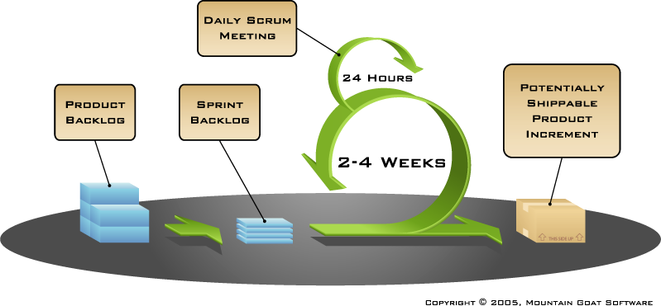
How Scrum Works?

Slide 9
Sprints
Scrum projects make progress in a series of “sprints”
Analogous to XP iterations
Target duration is one month
+/- a week or two
But a constant duration leads to a better rhythm
Product is designed, coded, and tested during the sprint

Slide 10
Sequential vs. Overlapping Dev.
Requirements
Design
Code
Test

Slide 11
No changes during the sprint
Change
Inputs
Sprint
Tested Code
Plan sprint durations around how long you can commit to keeping change out of the sprint

Slide 12
Scrum Framework
Roles : Product Owner, ScrumMaster, Team
Ceremonies : Sprint Planning, Sprint Review, Sprint Retrospective, & Daily Scrum Meeting
Artifacts : Product Backlog, Sprint Backlog, and Burndown Chart

Slide 13
Product Owner
Define the features of the product
Decide on release date and content
Be responsible for the profitability of the product (ROI)
Prioritize features according to market value
Adjust features and priority every iteration, as needed
Accept or reject work results.

Slide 14
The Scrum Master
Represents management to the project
Responsible for enacting Scrum values and practices
Removes impediments
Ensure that the team is fully functional and productive
Enable close cooperation across all roles and functions
Shield the team from external interferences

Slide 15
Scrum Team
Typically, 5-10 people
Cross-functional
QA, Programmers, UI Designers, etc.
Members should be full-time
May be exceptions (e.g., System Admin, etc.)
Teams are self-organizing
What to do if a team self-organizes someone off the team??
Ideally, no titles but rarely a possibility
Membership can change only between sprints

Slide 16
Ceremonies
Sprint Planning Meeting
Sprint
Daily Scrum
Sprint Review Meeting

Slide 17
Sprint Planning Meeting
Product Owner
Scrum Team
Customers
Management
Product Backlog
Sprint Planning
Meeting
Team Capabilities
Sprint Goal
Business Conditions
Technology
Sprint Backlog
Current Product

Slide 18
Parts of Sprint Planning Meeting
1st Part:
Creating Product Backlog
Determining the Sprint Goal.
Participants: Product Owner, Scrum Master, Scrum Team
2nd Part:
Participants: Scrum Master, Scrum Team
Creating Sprint Backlog

Slide 19
Pre-Project/Kickoff Meeting
A special form of Sprint Planning Meeting
Meeting before the begin of the Project

Slide 20
Sprint
A month-long iteration, during which is incremented a product functionality
NO outside influence can interfere with the Scrum team during the Sprint
Each Sprint begins with the Daily Scrum Meeting

Slide 21
Daily Scrum
Parameters
Daily
15-minutes
Stand-up
Not for problem solving
Three questions:
What did you do yesterday
What will you do today?
What obstacles are in your way?
Chickens and pigs are invited
Help avoid other unnecessary meetings
Only pigs can talk

Slide 22
Daily Scrum
Is NOT a problem-solving session
Is NOT a way to collect information about WHO is behind the schedule
Is a meeting in which team members make commitments to each other and to the Scrum Master
Is a good way for a Scrum Master to track the progress of the Team

Slide 23
Scrum FAQs
Why daily?
“How does a project get to be a year late?”
“One day at a time.”
Fred Brooks, The Mythical Man-Month.
Can Scrum meetings be replaced by emailed status reports?
No
Entire team sees the whole picture every day
Create peer pressure to do what you say you’ll do

Slide 24

Sprint Review Meeting
Team presents what it accomplished during the sprint
Typically takes the form of a demo of new features or underlying architecture
Informal
2-hour prep time rule
Participants
Customers
Management
Product Owner
Other engineers

Slide 25
Sprint Retrospective Meeting
Scrum Team only
Feedback meeting
Three questions
Start
Stop
Continue
Don’t skip for the first 5-6 sprints!!!

Slide 26
Product Backlog
A list of all desired work on the project
Usually, a combination of
story-based work (“let user search and replace”)
task-based work (“improve exception handling”)
List is prioritized by the Product Owner
Typically, a Product Manager, Marketing, Internal Customer, etc.

Slide 27
Product Backlog
Requirements for a system, expressed as a prioritized list of Backlog Items
Is managed and owned by a Product Owner
Spreadsheet (typically)
Usually is created during the Sprint Planning Meeting
Can be changed and re-prioritized before each planning meeting

Slide 28
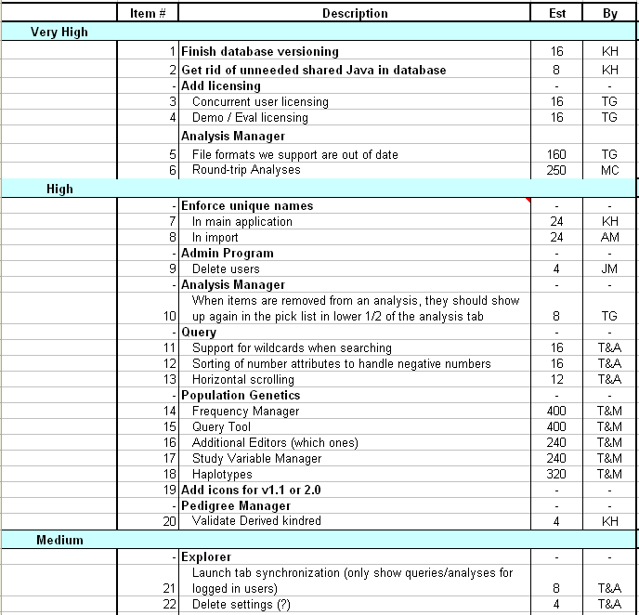
Sample Product Backlog

Slide 29
From Sprint Goal to Sprint Backlog
Scrum team takes the Sprint Goal and decides what tasks are necessary
Team self-organizes around how they’ll meet the Sprint Goal
Manager doesn’t assign tasks to individuals
Managers don’t make decisions for the team
Sprint Backlog is created

Slide 30
Sprint Backlog during the Sprint
Changes
Team adds new tasks whenever they need to in order to meet the Sprint Goal
Team can remove unnecessary tasks
But: Sprint Backlog can only be updated by the team
Estimates are updated whenever there’s new information

Slide 31
Sprint Backlog
A subset of Product Backlog Items, which define the work for a Sprint
Is created ONLY by Team members
Each Item has its own status
Should be updated every day

Slide 32
Sprint Backlog
No more than 300 tasks in the list
If a task requires more than 16 hours, it should be broken down
Team can add or subtract items from the list. Product Owner is not allowed to do it

Slide 33
Sprint Burn down Chart
Depicts the total Sprint Backlog hours remaining per day
Shows the estimated amount of time to release
Ideally should burn down to zero to the end of the Sprint
It is not a straight line
Can bump UP

Slide 34
Information Radiator
“ Two characteristics are key to a good information radiator. The first is that the information changes over time. This makes it worth a person's while to look at the display... The other characteristic is that it takes very little energy to view the display."

Slide 35
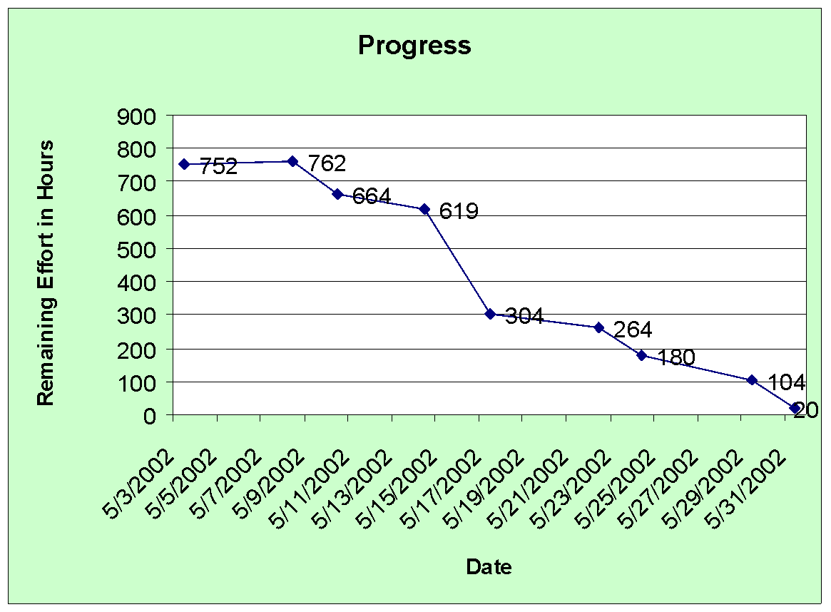
Sprint Burndown Chart

Slide 36
Release Burndown Chart
Will the release be done on right time?
X-axis: sprints
Y-axis: number of hours remaining
The estimated work remaining can also burn up

Slide 37
Product Burndown Chart
Is a “big picture” view of project’s progress (all the releases)

Slide 38
Pros/Cons
Advantages
Completely developed and tested features in short iterations
Simplicity of the process
Clearly defined rules
Increasing productivity
Self-organizing
each team member carries a lot of responsibility
Improved communication
Combination with Extreme Programming
Drawbacks
“Undisciplined hacking” (no written documentation)
Violation of responsibility
Current mainly carried by the inventors

Slide 39
Scrum vs Kanban
Agile Project Management with Kanban
Scrum vs Kanban | Differences & Similarities Between Scrum & Kanban
Scrumban??????

Slide 40
Thank You !!!

